Slide 1
Analyst Portfolio Project
Getting Smart with Jira and Confluence
Notes:
This is a presentation of how I used Jira and Confluence to manage my own personal project.

Slide 2
Table of Contents
Overview
Project Components
Project Management
Project Documentation
Project Portability

Slide 3
Overview
Even though I am the only person working on this project, it is important that I hold myself accountable for the work to be done.
Objective: Two birds, one stone. Gain hands-on experience with an industry tool while managing value delivery for my portfolio.
ToC
Notes:
After I started working on building my website and analyzing a set of data, I decided that I’d better get a project management system in place to prevent scope creep and help me break down the work to be done. Since Jira is a commonly used product and I had already received basic training for it, I decided to use it to track my project deliverables and schedule.

Slide 4
Project Components
A la Jira
ToC
Notes:
This section includes screenshots of how I record Epics, Stories, Tasks, Subtasks and Bugs.

Slide 5
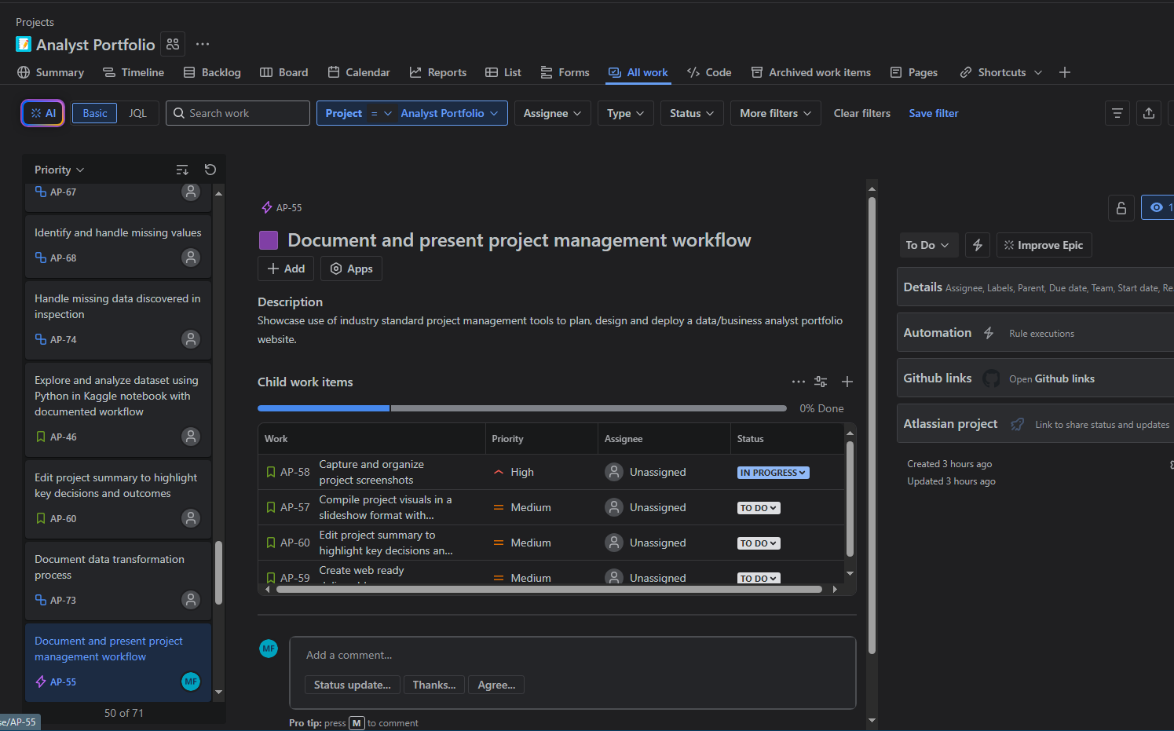
Epic
The grand narrative of smaller stories and tasks.
ToC
Notes:
When I started building the portfolio project in Jira, I consulted with ChatGPT to verify that I was correctly breaking down the layers of work. I didn’t want to be using Jira as a glorified to-do list. Through conversation, ChatGPT helped me understand the relationship between epics, stories and tasks better and we collaborated on verbiage.

Slide 6
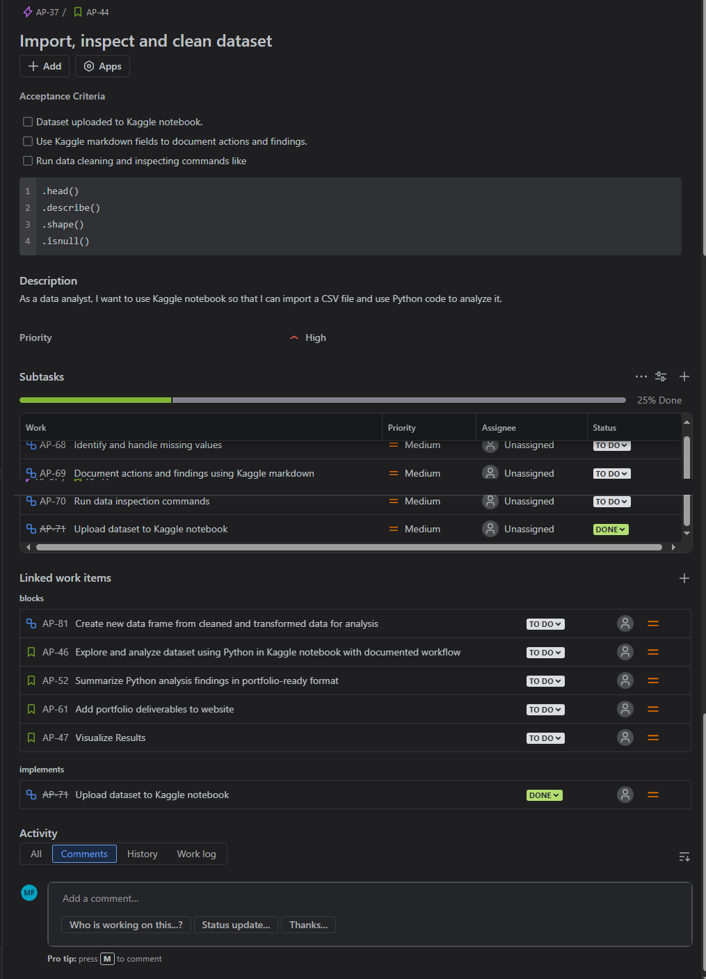
Story
A smaller chunk of the epic
Description is formatted like a user story
I added the “Acceptance Criteria” field to help scope the work
ToC
Notes:
My experience as an Emerging Technology Analyst in the Office of Online Services at the IRS taught me the importance of requirements elicitation. As a single-member project team, I need acceptance criteria as part of my stories so that I have a written Definition of Done and visible scope of work. I am susceptible to the black hole of perfectionism and having a checklist that tells me when enough is enough is very handy. If I want to do more, it becomes a new story or task and gets added to the backlog!
Also, formatting the descriptions as user stories helps me scope the work. It simplifies the work into what the feature is, who it’s for and how it gives value. This not only helps with scope but also with backlog refinement.

Slide 7
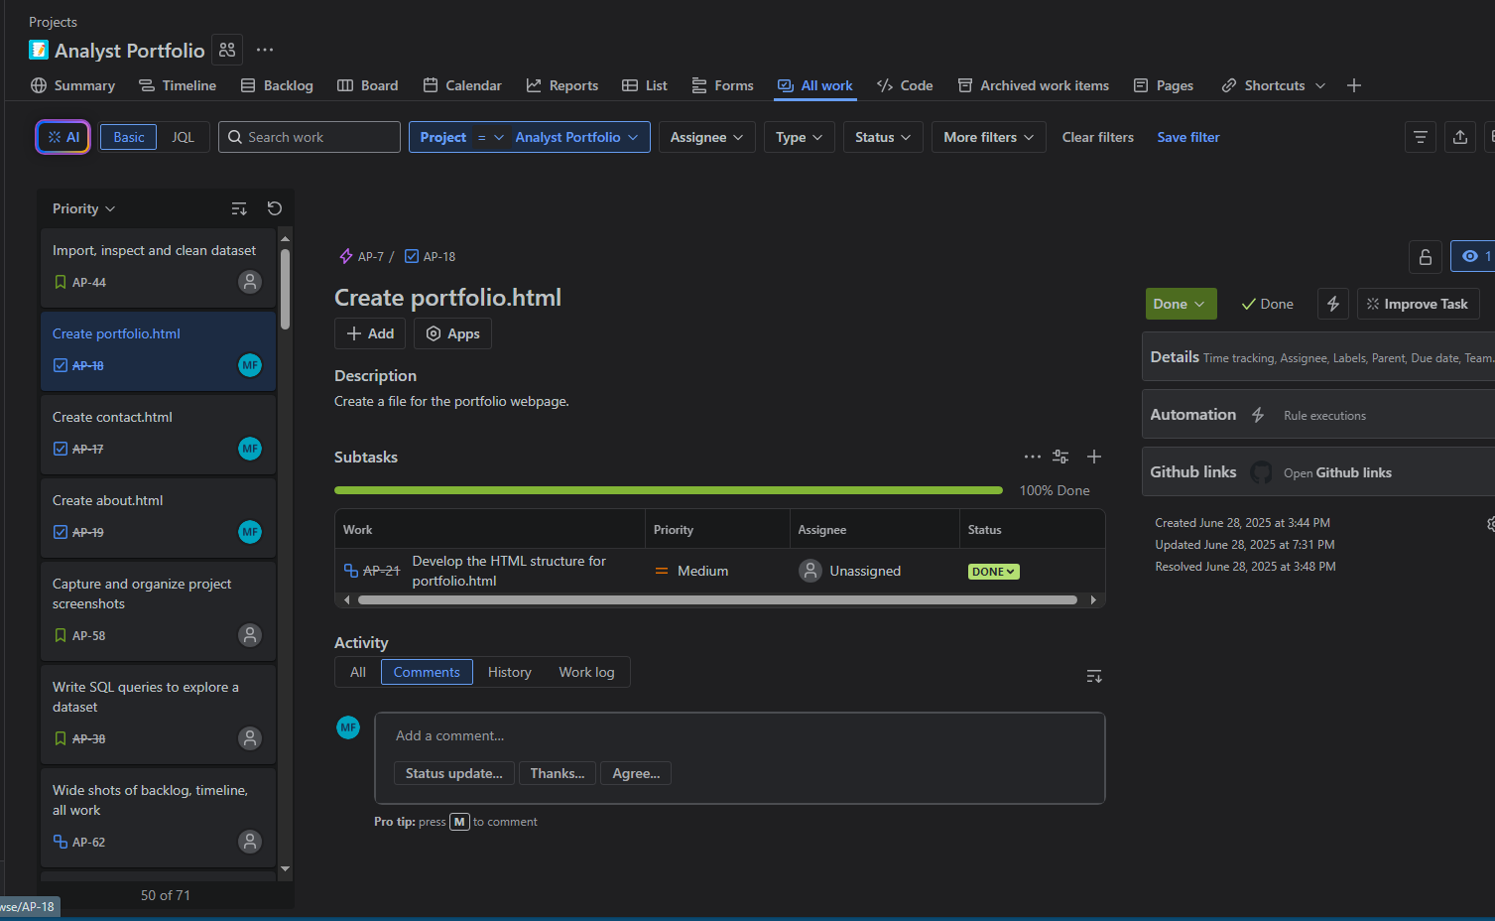
Task
Simple, just a thing to do.
ToC
Notes:
The slide says it all. 🤣

Slide 8
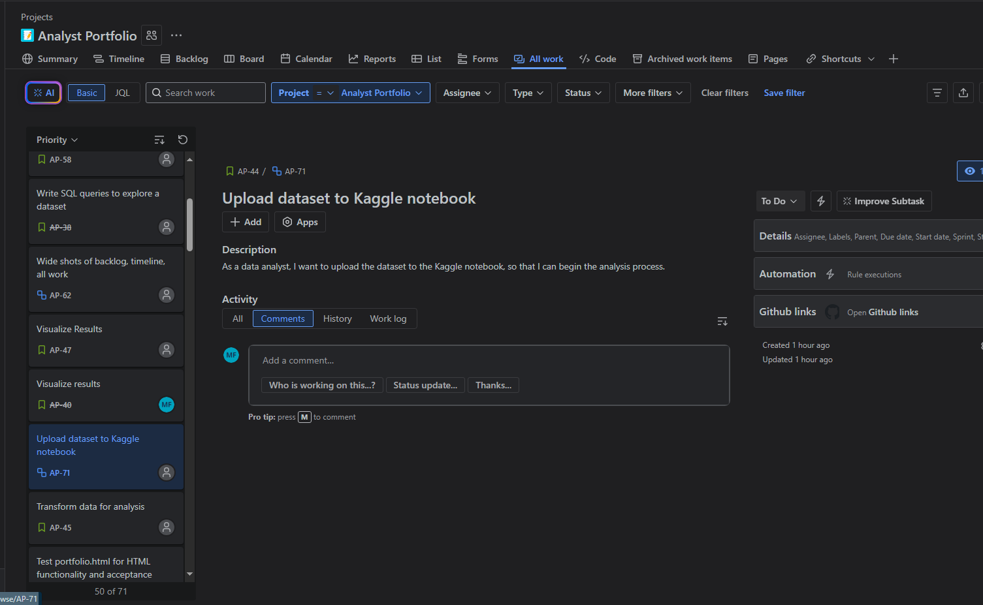
Subtask
The pieces of work that support meeting the story’s acceptance criteria.
ToC
Notes:
Scope of work is very important to project completion. I have a tendency to forget steps and will underestimate the effort needed to get something done. By breaking the stories into subtasks, and collaborating with ChatGPT to make sure I don’t forget anything, I am able to appropriately assign myself work in sprints. I have instructed ChatGPT to use the Socratic method with me because I don’t like to be handed answers, I like to get to them on my own.

Slide 9
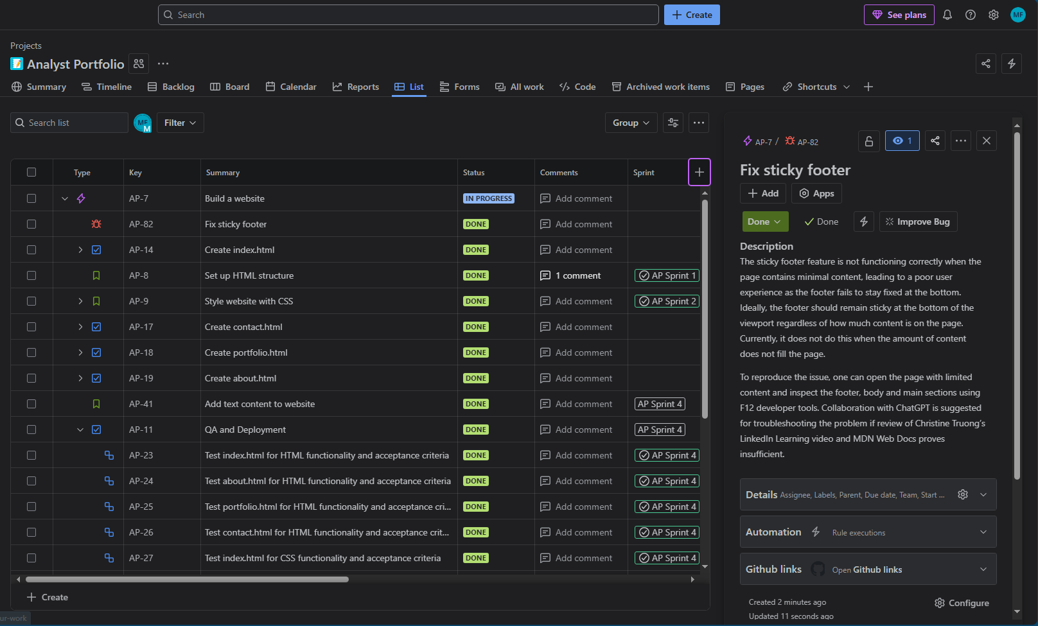
ToC
Bug: An issue that needs fixing
Notes:
Ah, bugs! When you finally finish a task and think you’ve checked everything, but then something comes out of left field. I had not used this feature much when I started my project because I saw it as applying to literal product development more. However, as I progress into the maintenance phase of building my website I see it as more useful because I need to not put off a task in the active sprint to fix a but. Everything needs to wait for its turn!

Slide 10
Project Management
Jira Desktop
ToC

Slide 11
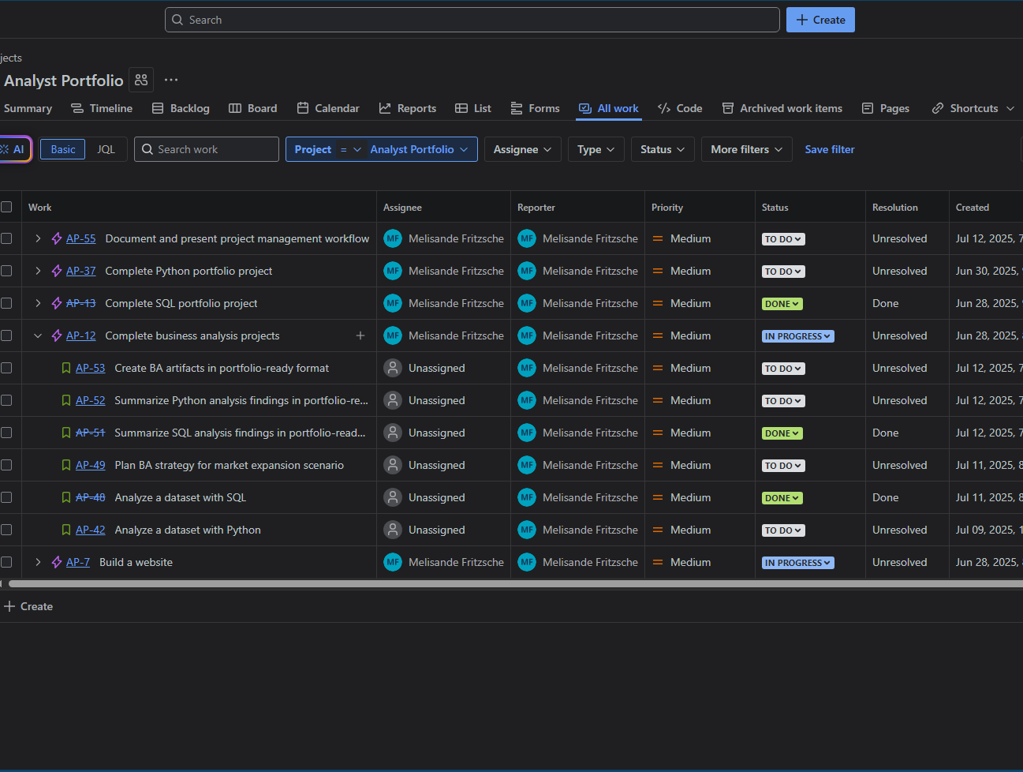
All Work
Where I go to see everything I’ve done and everything I’ve yet to do.
ToC
Notes:
This is where I usually start when I don’t have an active sprint. I like to get a big picture view of the project before diving in to work to keep things in perspective.

Slide 12
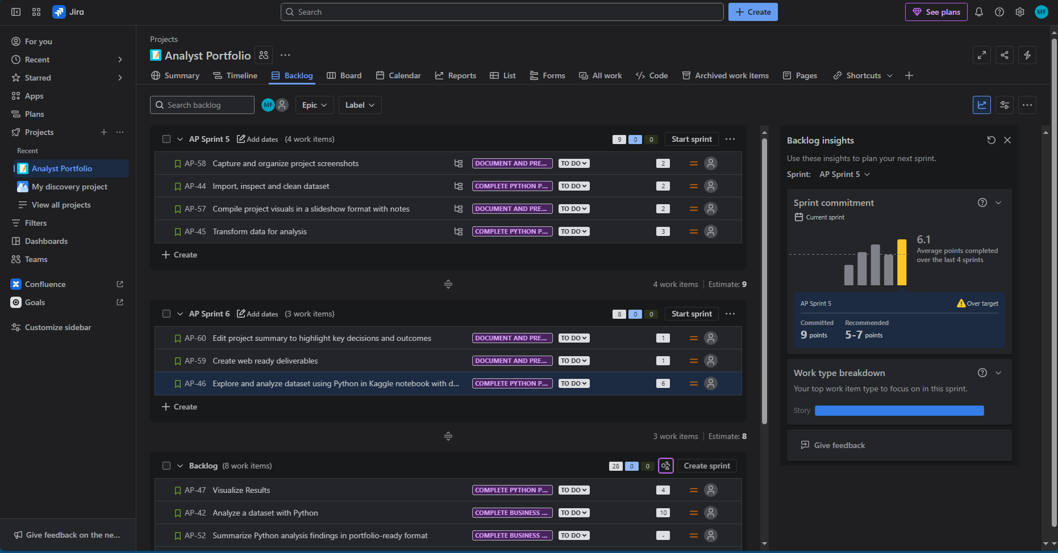
Backlog Filling
Keeping track of all my project’s stories
Using the built-in tools to ensure I avoid burnout and missed deadlines
ToC
Notes:
When I learn a new tool, I usually operate with a “click buttons and see what happens” mentality. Atlassian is nice enough to have tool tips to give me a hint of what any button might do prior to clicking. I appreciate the insights offered…

Slide 13
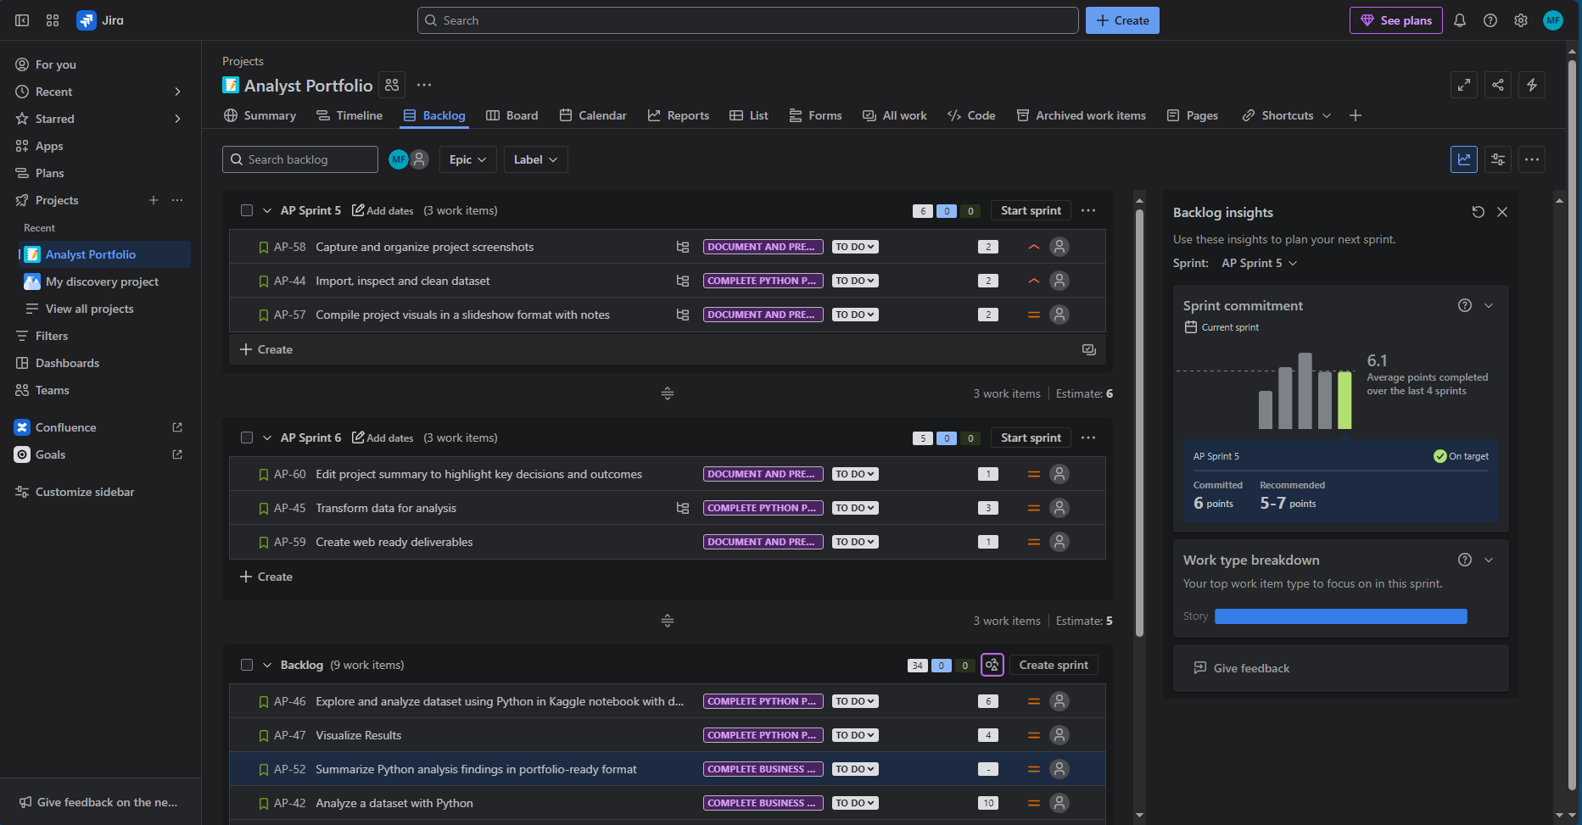
Backlog Refinement
Adjusting the backlog to optimize delivery
Prioritizing tasks based on value and effort
ToC
Notes:
…and actually use them. That’s why they’re there. My use case definitely benefits from strict adherence to the backlog insights because I am the only worker. I wish that the priority field was easier to edit or that it defaulted to null. I don’t think it’s worth it to go through and adjust them all for my use case, but it makes me uncomfortable having them all be there and all be “medium”.

Slide 14
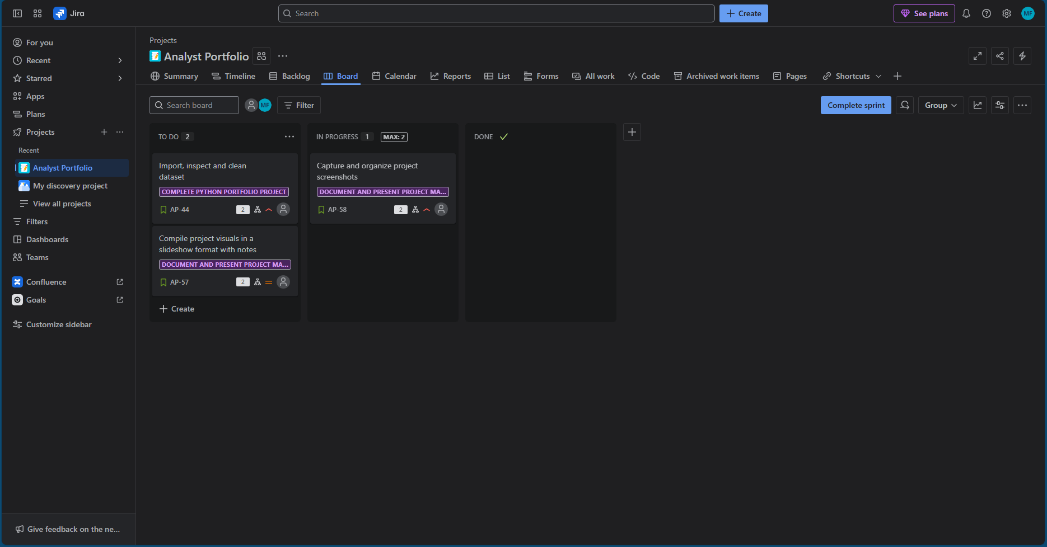
The Board
ToC
I love moving work from one bucket to another!
I made sure to put a limit on work in progress to mitigate my overconfidence.
Notes:
I was disappointed that the free version of Jira does not support Kanban. Working based on work in progress (WIP) load and emphasizing flow of work items fits my work management mentality better, and for my use case it would have been a better set-up. It’s unfortunate that whiteboards use so much bandwidth, but I think I’ll try to prioritize my backlog after my next sprint using the whiteboard integration with Confluence.

Slide 15
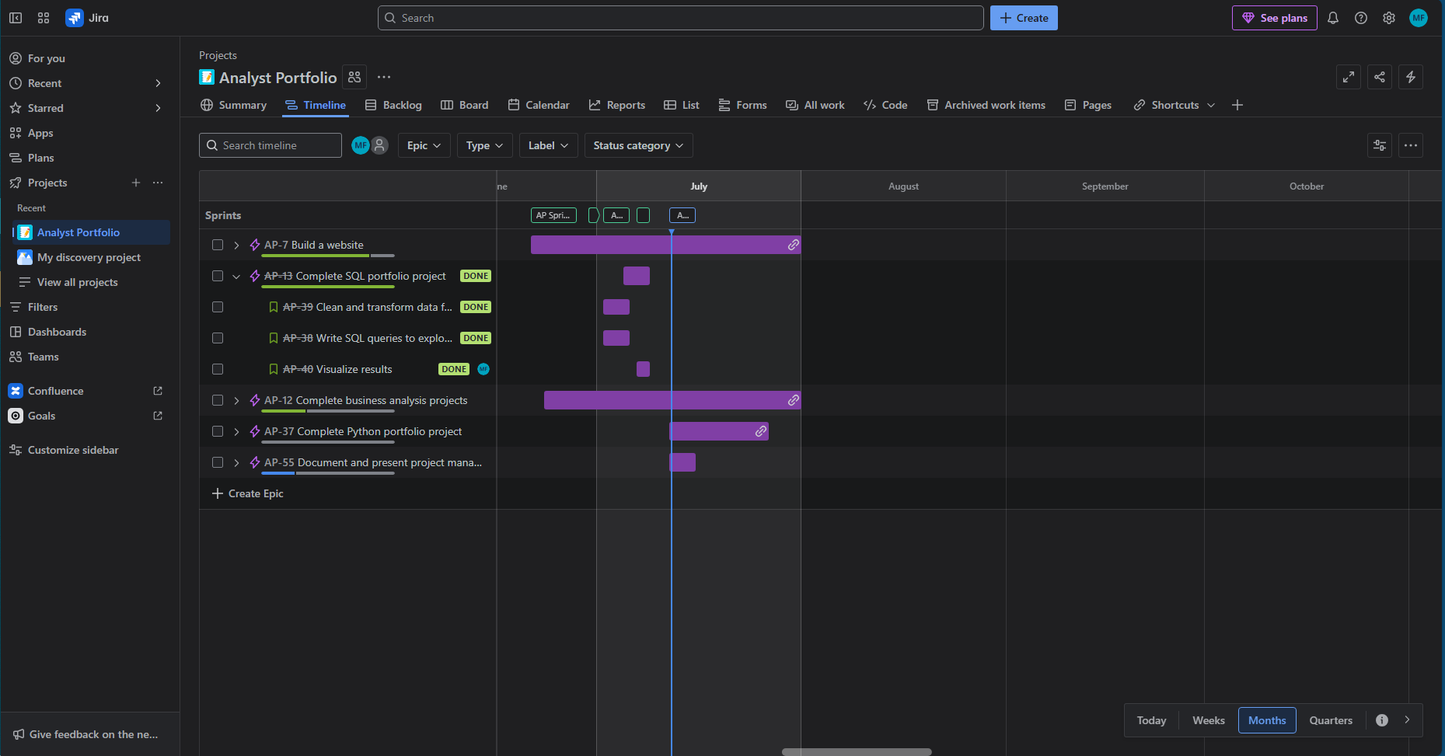
Timeline - Month View
ToC
Getting a Gantt-esque view of the project as a whole
Notes:
I do have links between work items, but they don’t have high visibility on the timeline. I am trying to deliver value in a short amount of time. One of my project assumptions is that I have the intelligence and energy to do this. 😏

Slide 16
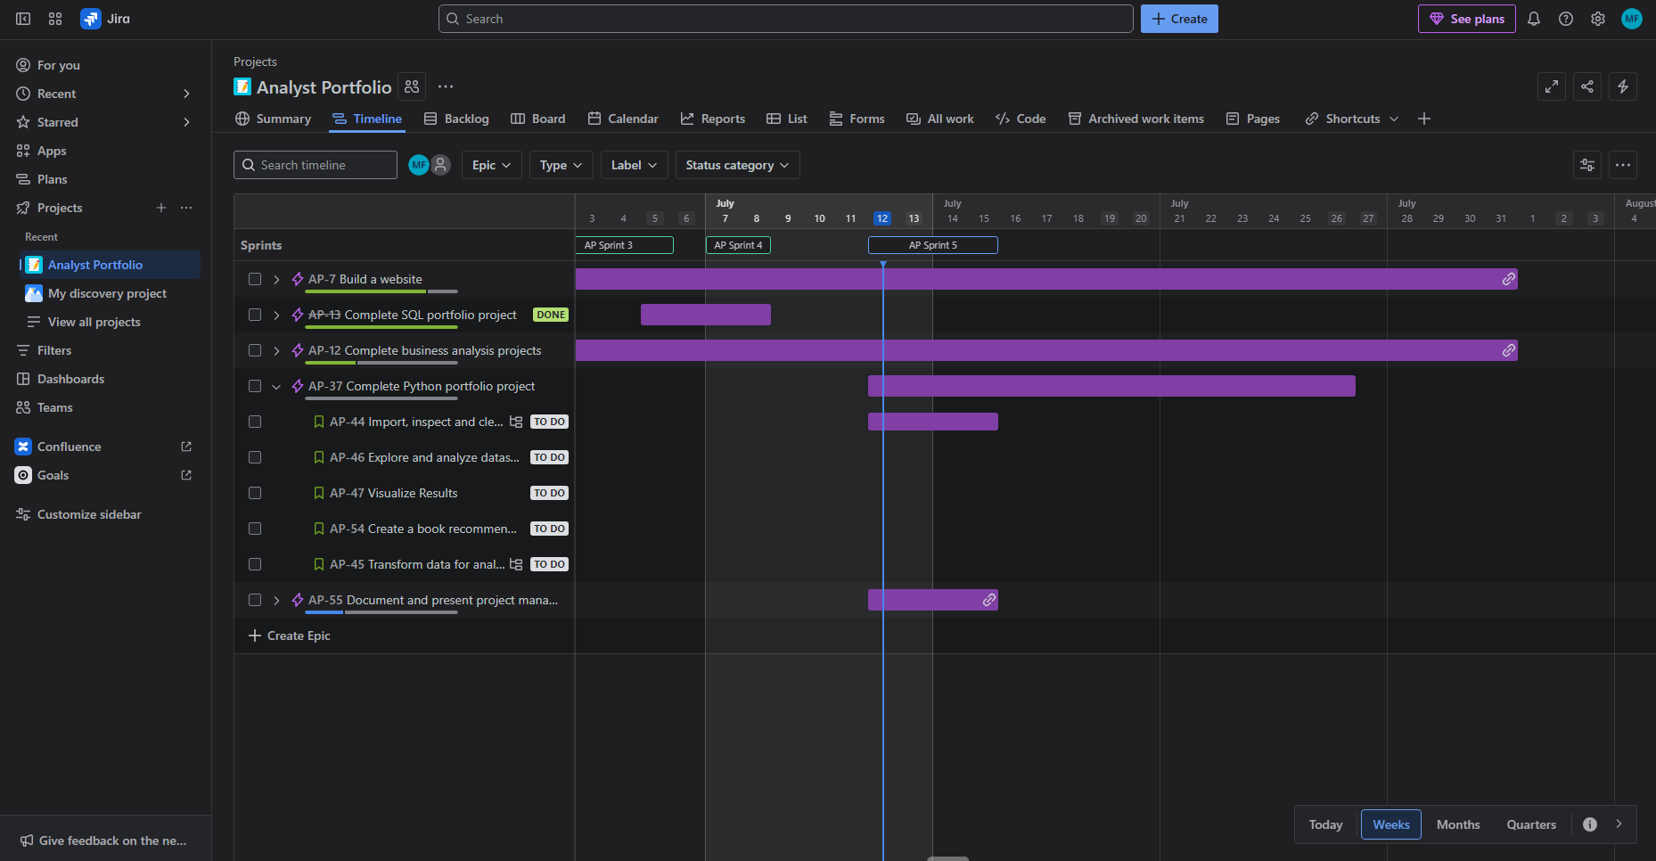
Timeline - Week View
Using the timeline to get a more granular view of the work to be done.
ToC
Notes:
When I want to see the trees for the forest I come to the timeline view. I need to see all the pieces of work that add value to the story. Work breakdown structure for the win!

Slide 17
Project Documentation
Confluence Desktop
ToC

Slide 18
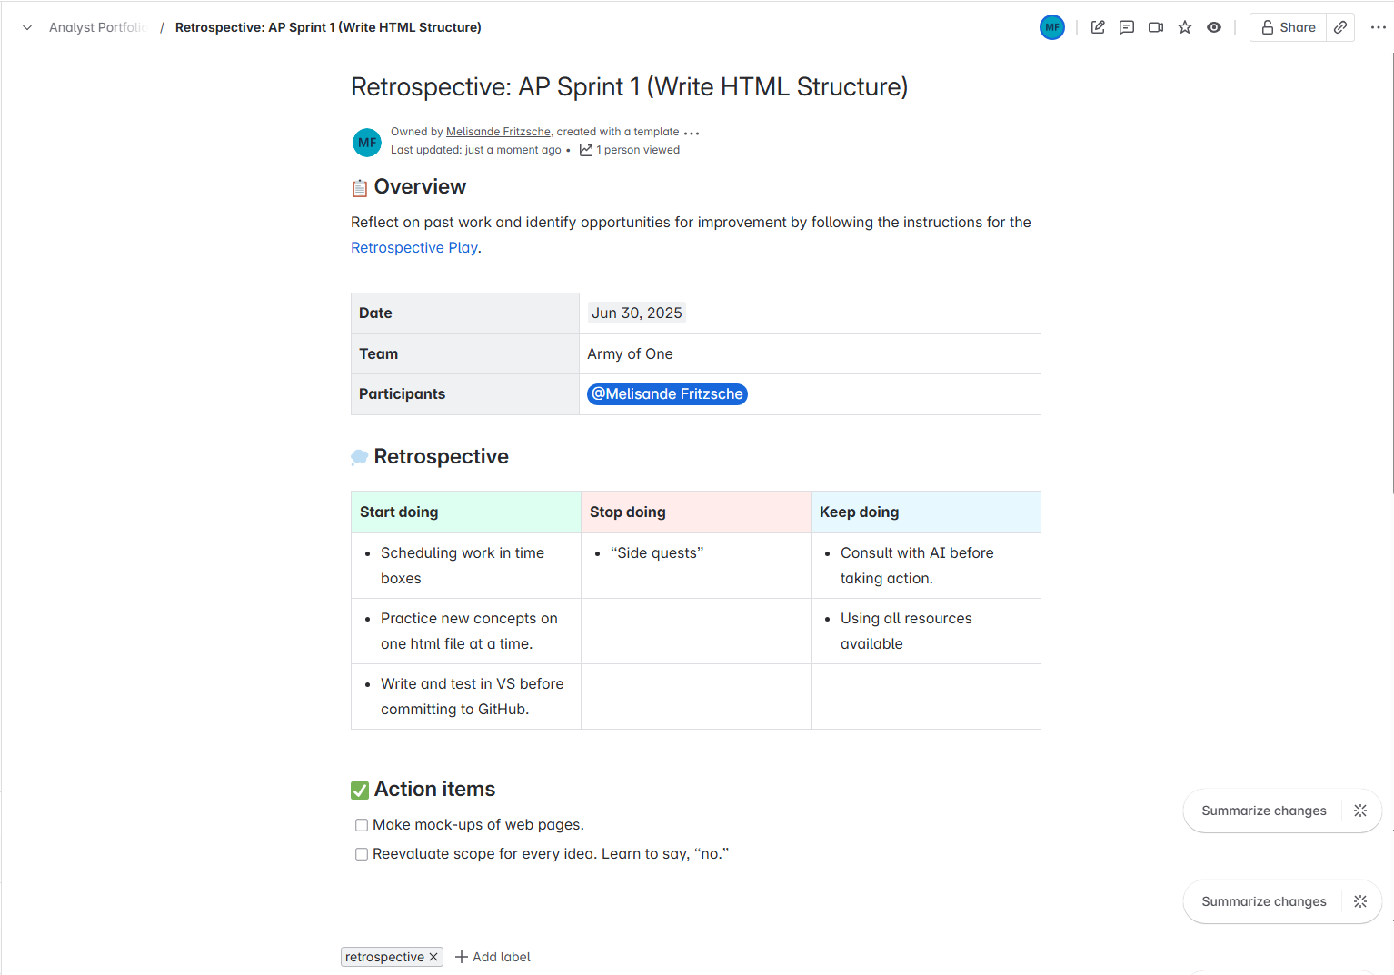
Retrospective
First sprint retrospective
Holding myself accountable for correcting poor behaviors
ToC
Notes:
Hooray for lessons learned and retrospectives! Being a one-person team, there’s less bonding and collaboration involved, but I do these to hold myself accountable. I have ego and I need to acknowledge when I overestimate my abilities or make decisions with unintended or detrimental consequences.
Being able to acknowledge what I am doing well, what I’m not doing well and what I have discovered that could help me succeed is a great help. Also, writing things down increases neural pathways and memories so now I will never not use F12 dev tools to troubleshoot a webpage ever again.

Slide 19
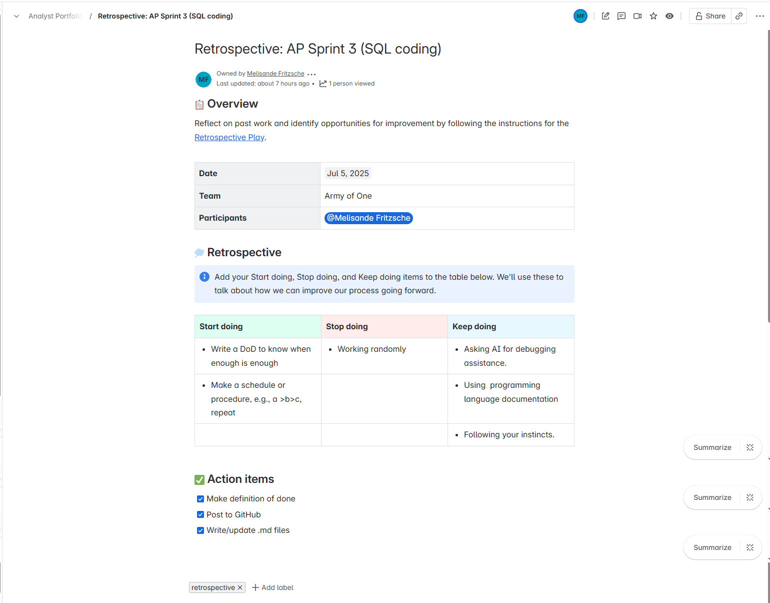
Retrospective
Third sprint retrospective
List and complete action items to improve future sprints
ToC
Notes:
Hopefully we see positive shifts in my leveraging of the the retrospective…

Slide 20
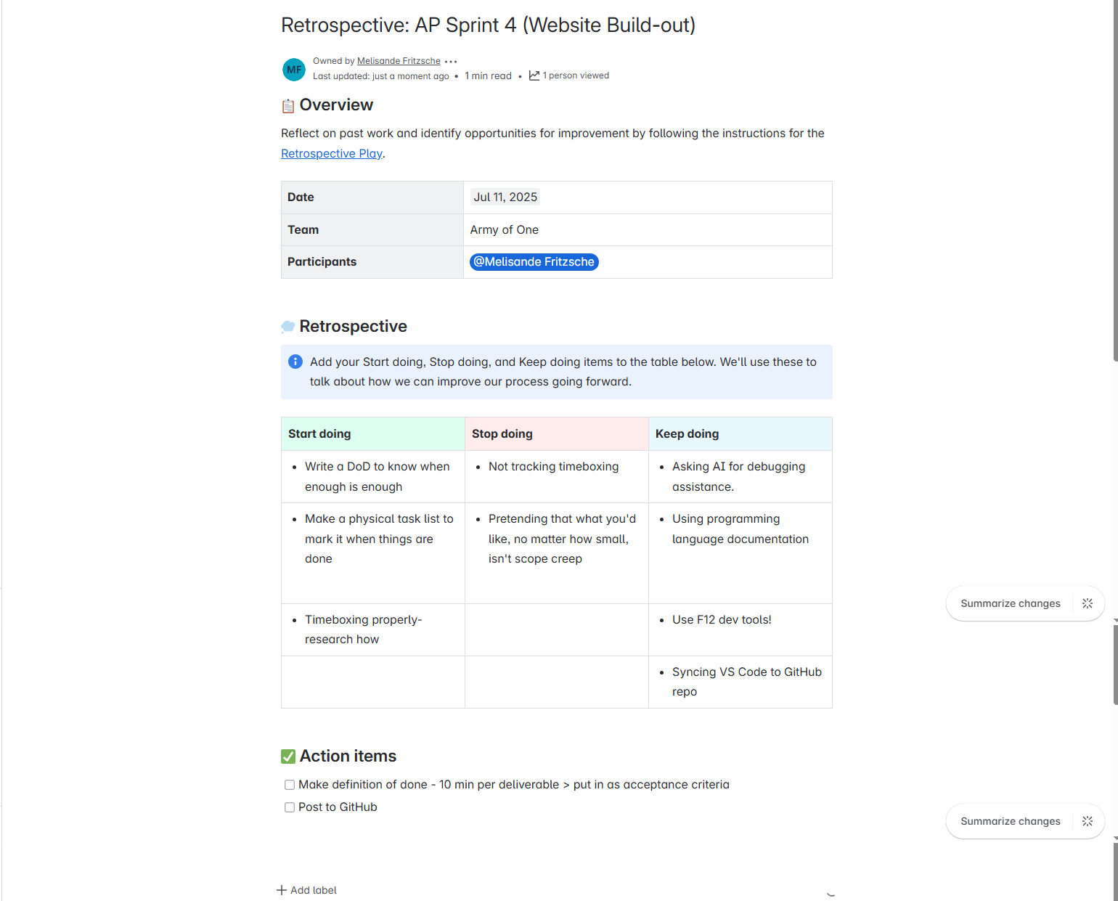
Retrospective
Fourth sprint retrospective
Having different work types in the project means different lessons learned
Refining the learning process
ToC
Notes:
I had another collaboration session with ChatGPT to verify whether I was completing these retrospectives properly. I also asked when the action items were supposed to be marked completed. ChatGPT suggested that I get more specific about the action items, giving timeframes and details, which I added here. They also made suggestions via questions about how to fill out the table. Prior to our conversation, my “Stop doing” had been blank even though I knew that I had done things that had hindered progress on the sprint tasks. The questions it asked helped me articulate the things that I had done that I should try and stop.

Slide 21
Project Portability
Mobile Apps
ToC

Slide 22
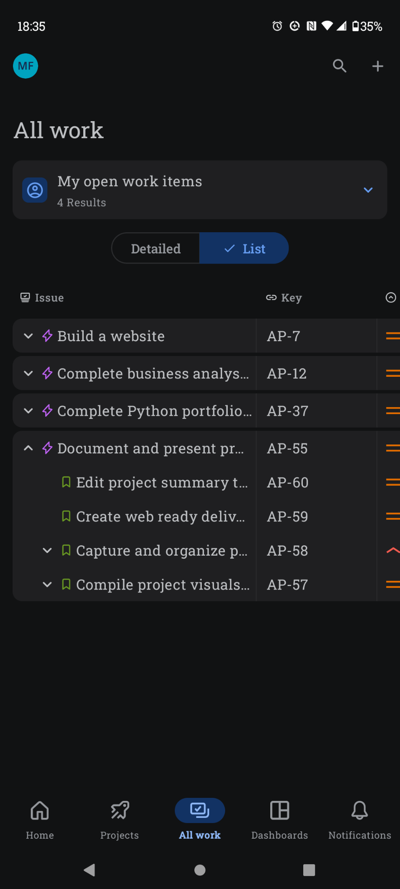
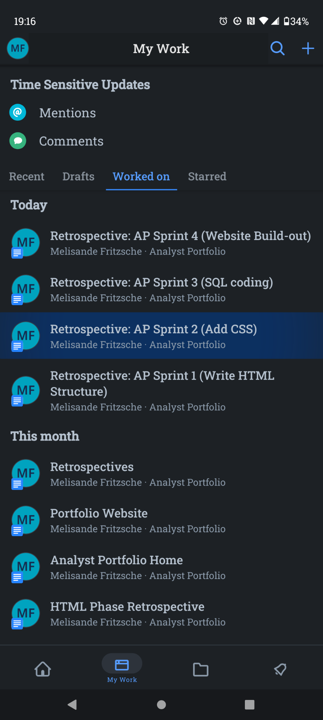
Mobile Updates
Downloaded the Jira and Confluence apps to my phone so I can add ideas to the backlog as they occur to me or edit a document anytime
Log and track the time I spend working on tasks
Start a retrospective as soon as I finish a sprint
ToC
Notes:
My brain doesn’t switch off except for maybe five minutes while I’m sleeping. Having Jira on my phone lets me input updates like logging time and changing the work status of a task when I’m not at my computer. Similar to the Jira app, it is helpful to be able to work on project documents in Confluence on my phone while sitting anywhere. Luckily, I have a bluetooth keyboard, which makes typing at scale easier.

Slide 23
ToC

